Slide 1
DCAITI-Project:
Intelligent rear-view mirror for cyclist on Smartphones
Oday Kabha oday.kabha@ipk.fraunhofer.de
Shan Han hanshann09@gmail.com
name @mailbox.tu-berlin.de
Supervisor: Macus
Notes:
1

Slide 2
Overview
Idea
Develop Framework
Milestone
2
18.11.2020
DCAITI -Projekt

Slide 3
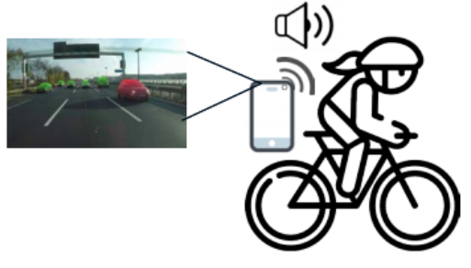
1. Idea
Object Detection & Tracking:
Smartphone cam
Additional cam
Image processing Algorithms
Measurement of Distance & Speed:
Simple smartphone cam using image processing algorithms
LiDAR
Notifications & Warnings
When objects too close or too fast
Android Notification Reciever
3
18.11.2020
DCAITI -Projekt
Notes:
3

Slide 4
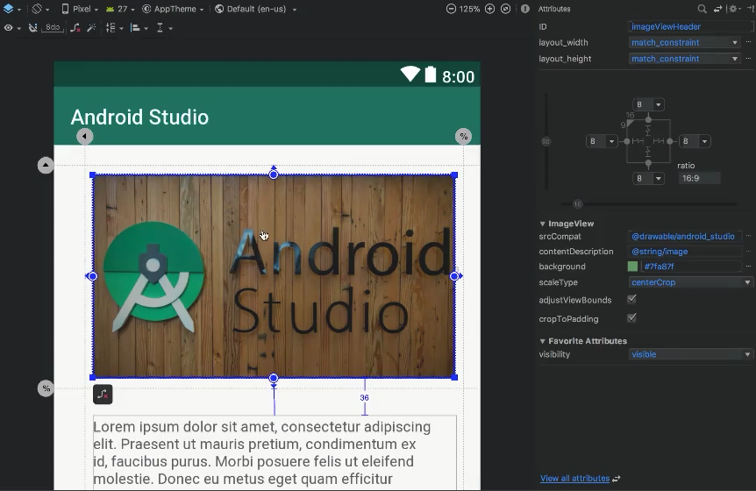
2. Develop Framework
Android Studio
Visual layout editor
build layouts by dragging UI elements instead of writing layout XML by hand
4
18.11.2020
Source: https://developer.android.com/studio
DCAITI -Projekt

Slide 5
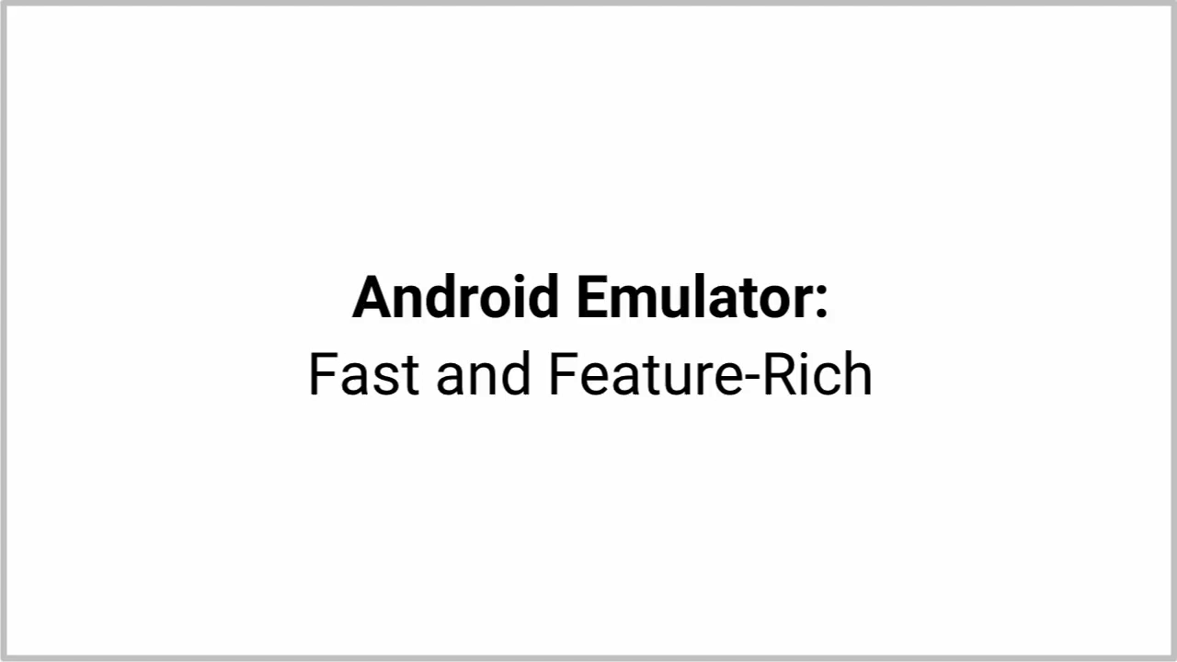
2. Develop Framework
Android Studio
Fast emulator
run apps on the Android Emulator
5
18.11.2020
Source: https://developer.android.com/studio
DCAITI -Projekt
Notes:
5

Slide 6
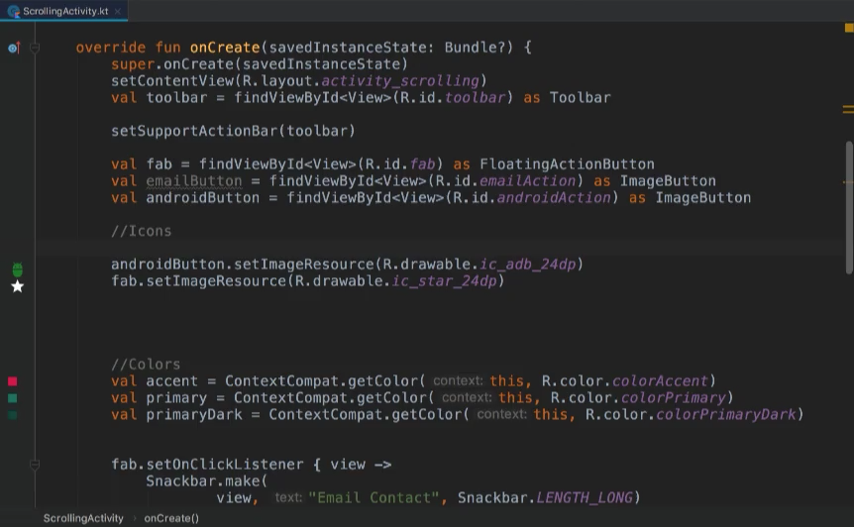
2. Develop Framework
Android Studio
3. Intelligent code editor
based on IntelliJ IDEA
6
18.11.2020
Source: https://developer.android.com/studio
DCAITI -Projekt
Notes:
6

Slide 7
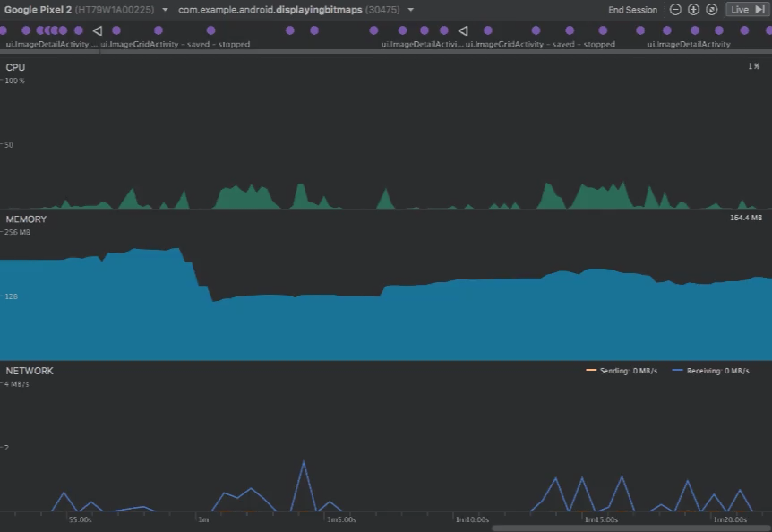
2. Develop Framework
Android Studio
4. Realtime profilers
measure app performance
7
18.11.2020
Source: https://developer.android.com/studio
DCAITI -Projekt
Notes:
7

Slide 8
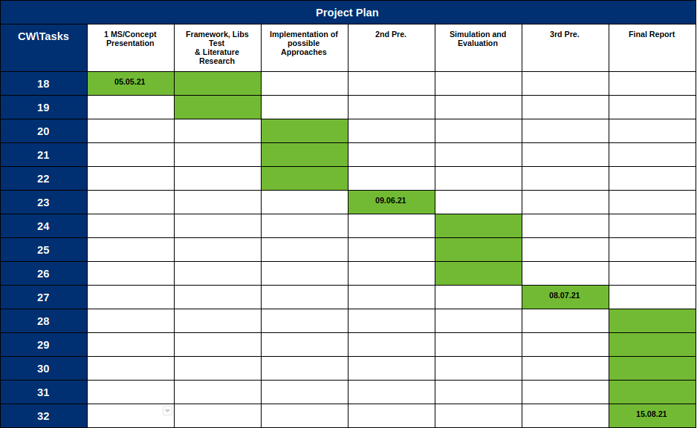
3. Milestone
8
18.11.2020
DCAITI -Projekt

Slide 9
Thanks for your attention!
Oday Kabha oday.kabha@ipk.fraunhofer.de
Shan Han hanshann09@gmail.com
name name@mailbox.tu-berlin.de
Notes:
9

